Slide 1

Name:Aashish Kumar
Roll No.: 38
Prn No.: 2014111065
This will happen when your resume is just ORDINARY..
Notes:
You can look in the picture that your resume will be stacked with others if your resume is just plain ordinary..
So, by attending this course, I hope that you can open your mind to something different and I will show you how some simple acts of “common sense” can make your resume stand out from the crowd..
In other words, to be seen is to be different in a good way
<number>

Slide 2
An outstanding resume will attract the attention of prospective employers.
Higher chance to get a job.
A resume should be brief, strong and “punchy”.
The job market nowadays is very challenging. So you resume needs to “lift” you up from the crowd.

Slide 3
Contents
Introduction to Resume
Writing a Good Resume
Do’s and Don’ts in Resume Writing

Slide 4
Contents
Introduction to Resume
Writing a Good Resume
Do’s and Don’ts in Resume Writing

Slide 5
Introduction to Resume
Topics covered:
Why a Resume is Important?
Differences between Resume and CV

Slide 6
Why a Resume is Important?
The first layer of your first impression.
A bad resume will bring you down.
The first step to attract your prospective employer.
Good resume = Employers will be waiting for you..

Slide 7
Differences between Resume and CV
Resume | CV
Resumes are much shorter than CVs (<=2 pages). Resumes only highlight your skills and accomplishments. | CV is suitable for providing more details. Used in the field of education, medicine, research and science.

Slide 8
Contents
Introduction to Resume
Writing a Good Resume
Do’s and Don’ts in Resume Writing

Slide 9
Writing a Good Resume
Topics covered:
Resume Structure
Useful Tips for Writing a Resume

Slide 10
Resume Structure
Resume objective
Career summary
Professional experience (include achievements)
Education
Affiliations (professional & community)
Technology skills
Honors and awards
Publications
Public speaking
Teaching experience
Foreign language and travel
Personal information

Slide 11
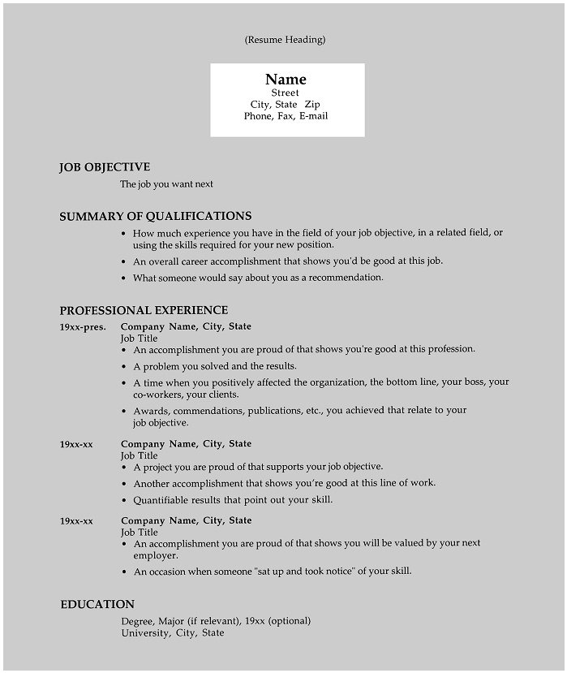
A good one-page resume
Notes:
A good one page resume format
<number>

Slide 12
Useful Tips for Writing a Resume
Tailored to the type of job you are seeking.
Highlight the qualifications which seem relevant to the job.
Describe about the experience that will add value to the job.
Networking card strategy (excellent for capturing the attention of employers).

Slide 13
Useful Tips for Writing a Resume (cont.)
Relate your experiences to the job that you wanted to apply. It shows your understandings about the job.
Use any document editing to develop a “catchy” and easily readable one page resume.
Write your name and page number on the second page (if you have a 2nd page).

Slide 14
Contents
Introduction to Resume
Writing a Good Resume
Do’s and Don’ts in Resume Writing

Slide 15
Do’s and Don’ts in Resume Writing
Topics covered:
Do’s
Don’ts

Slide 16
Do’s
Perfection is mandatory.
A resume should be unique.
Focus on your dream job. Write “around” it.
Less is more! (your boss is a busy guy)
Include relevant info. (Degree, attended courses and seminars, classes, workshops and certificates).
The list of references should be written in a separate page.

Slide 17
Do’s (cont.)
Use the suitable font (Size 11 or 12 is okay. 10 is too small).
Use a good quality paper.

Slide 18
Don’ts
Don’t write too much about your past.
Do not confess everything in your resume.
Do not write a general resume that you tend to send to all employers (Be unique!).
Do not write the description of your previous jobs but focuses more on the achievements.
Do not write about the descriptions that you do not like to do from the previous job.

Slide 19
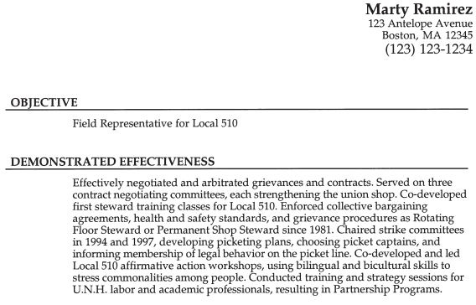
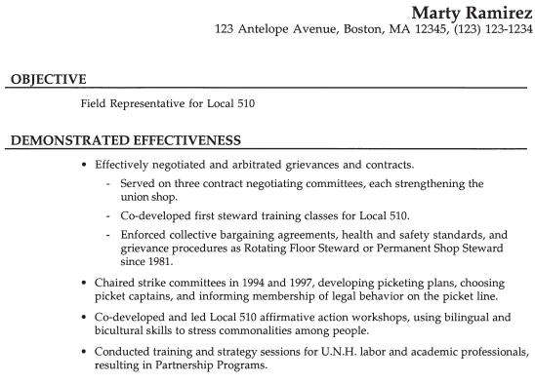
Don’ts (cont.)
Do not write in paragraph. Use bullet points
Which one is easier to read?

Slide 20
Don’ts (cont.)
Do not include private information such as the salary history, personal and family information, your account number and others.
Avoid lying in your resume! (It is not worth it).

Slide 21
Contents
Introduction to Resume
Writing a Good Resume
Do’s and Don’ts in Resume Writing

Slide 22
Concluding Remarks
A unique and job-specific resume is an important tool for job hunters.
A resume is an attention grabber. So it should be brief and “punchy”.
It can also highlights some the accomplishments that make the bosses think that you’re the one who fits for the job!

